Slide 1




C-WorKS: COVID-19 consequences –
Want it? or Know it? Share it!
C-WorKS: COVID-19 consequences
Want it?
Know it?
Share it!

Slide 2
Aims
C-WorKS primary aim is to bring people and organisations who will hold different pieces of knowledge and understanding together to enable more effective, equitable and efficient ways of working across the whole region.
C-WorKS will facilitate sharing of information, reduce duplication, highlight gaps and maximise the value of non-COVID, system-wide work done in this region
C-WorKS empowers members to add their own resources, post questions and proactively contact others who are working on similar issues.
C-WorKS will adapt overtime to make sure it best serves the needs and wants of its users.
C-WorKS: COVID-19 consequences
Want it?
Know it?
Share it!

Slide 3
Background
COVID-19, and measures to limit the spread of the virus, have had a huge impact on individuals, communities and care services. C-WorKS provides a regional, system-wide approach to share relevant knowledge and intelligence across the system.
The idea for C-WorKS evolved from a paper scoping the broader impacts of COVID-19 and lockdown. This document is regularly updated and the latest version can be accessed in the Library here (C-WorKS sign up required) or by emailing LKISNorthEast@phe.gov.uk
C-WorKS is hosted via the LKIS NE PHINE Network Khub group. Registration is required to view C-WorKS content. Registration is simple, free and open to all.
C-Works was formally launched on June 1st 2020.
C-WorKS: COVID-19 consequences
Want it?
Know it?
Share it!

Slide 4





Want it?
C-WorKS provides a forum to make links with people, groups and organisations who may have the intelligence you need, or those who are able to assist in answering your questions.
C-WorKS: COVID-19 consequences
Want it?
Know it?
Share it!

Slide 5
If you have knowledge and intelligence resources and/or analysis relating to the impact of COVID-19 on non-COVID health issues then C-WorKS provides a forum to tell others about this.
Know it?
C-WorKS: COVID-19 consequences
Want it?
Know it?
Share it!

Slide 6



SHARE IT!
By providing contact details within C-WorKS this will help to link people, groups and organisations together to share common areas of working, intelligence needs, resources and insights.
C-WorKS: COVID-19 consequences
Want it?
Know it?
Share it!

Slide 7
C-WorKS Launch
How it works (summary):-
On the C-WorKS site is curated information on non-COVID impacts, provided by users on an ongoing basis, in a structured framework.
Users can upload or describe information about work/ work in progress in each area, share contact details, view information, and communicate with colleagues via ‘comments’.
How we can use it:-
We officially launched C-WorKS in the region on 1st June – a comms pack with details is available to all.
Access is via the C-WorKS Knowledge Hub on the PHINE network (see next slide)
*** PLEASE USE C-WORKS ***
***PUT ALL OF YOUR NON-COVID WORK ON THERE – IT WILL ONLY WORK IF WE USE IT*** ***THANK YOU***
C-WorKS: COVID-19 consequences
Want it?
Know it?
Share it!

Slide 8
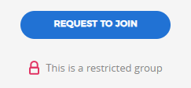
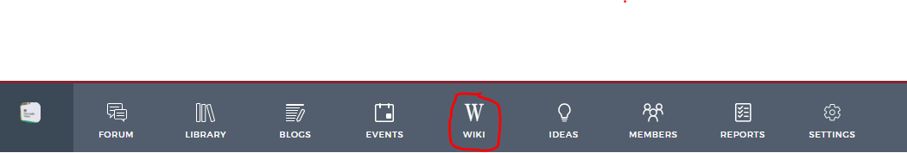
How to register
1: In order to access the C Works Knowledge Hub you will first need to register on Khub if you haven’t already. Please click here to set up your account.
2. Once your account has been created please navigate to the PHINE Network North East Group. This is a restricted group for those working within a public health remit, so you need to request access to join. Request access by clicking the ‘request to join’ button on the left-hand side of the front page.
3. Once access to PHINE Network North East has been granted please access the C-WorKS Knowledge hub via the landing page here or by clicking on the ‘wiki’ tab found across the top of the front page
C-WorKS: COVID-19 consequences
Want it?
Know it?
Share it!

